Slide 1
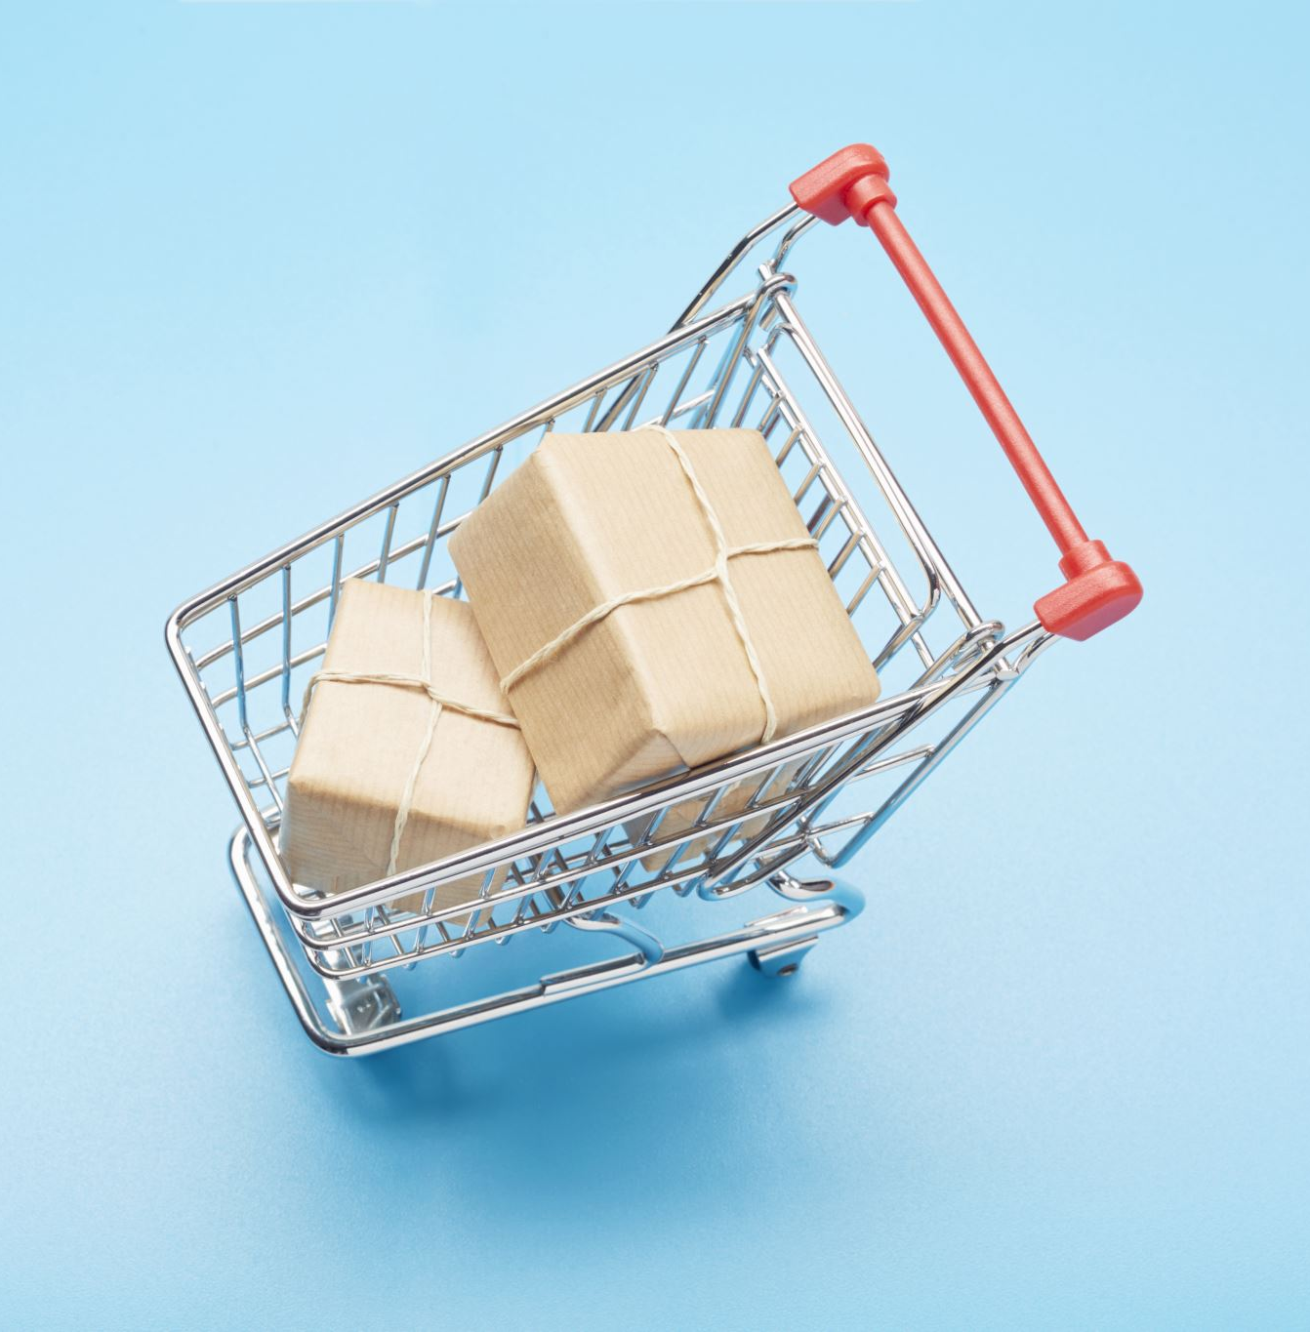
Cross-Selling, Upselling, and Purchase Propensity
Team Turquoise

Slide 2
Executive Summary:
Traffic optimisation: Implement personalized recommendations based on traffic source to enhance user experience. 40% of shoppers who clicked a personalized recommendation during their first visit came back.
Cross selling in pairs and by season: Product bundles based on common basket pairings and seasonal trends. 60.8% of basket pairs are from the same sub-category.
Potential for upselling: Offer alternatives to popular items and add-ons at checkout. 40% of T-Shirt sales, generates a profit of just £4.63 per unit.

Slide 3
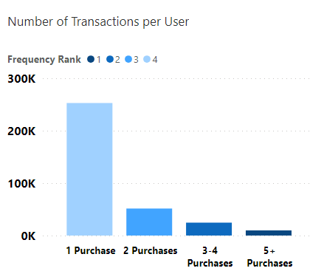
Defining Expected Customers
Using gained insights to define likely returning customers
RFM segmentation
Customer retention
Sources & behaviour for said customers
Purchases to actions similar on desktop and mobile (0.189 to 0.159)
Tradedoubler’s 0.313 highest value to rtbhouse’s 0.079.

Slide 4
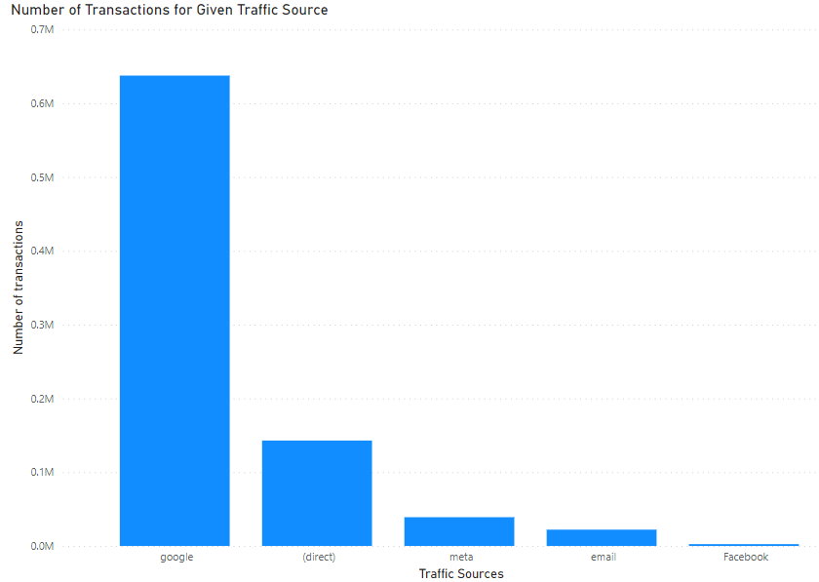
Traffic optimisation
33.74% of our total views come from meta, while only 4.08% lead to purchases.
Significantly, purchases are driven by Google and direct traffic, accounting for 66.67% and 14.97% respectively.
Social media is the primary source of growth, with a remarkable 215% increase year-on-year, compared to 61.6% for other traffic sources.
Improve SEO by creating high-quality content with relevant keywords to boost search engine rankings and increase organic traffic.
Implement personalized recommendations based on traffic source to enhance user experience and drive repeat visits.
Amplify content on social media to expand reach and attract more traffic to the website.
40% of shoppers who clicked a personalized recommendation during their first visit came back, compared to only 19% of shoppers who didn’t, potentially generating greater revenue. (Salesforce).

Slide 5
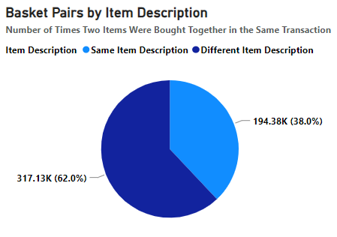
Matching pairs – basket pairs often variations of same item:
38% Basket Pairs have the same item brand, name and gender but different item ID
Men’s Prism T-shirt and Women’s Prism T-shirts were in 10.1% and 4.0% of all basket pairs respectively
Product bundles containing variations of the same item at a discounted price/ free shipping or with exclusive designs.
Increase average order value and revenue
For example, 133574 T-Shirts sold in 2022 for an average price of £7.90. If 5% of these purchases bought an additional T-shirt with a 10% discount that would be worth £47485 in additional revenue.

Slide 6
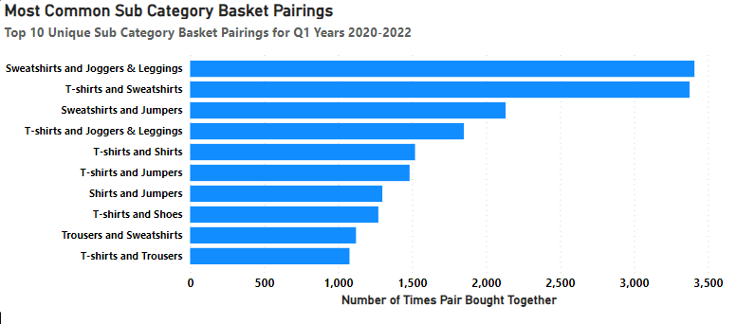
Wrap up – sweatshirts and jumpers popular for q1:
60.8% of basket pairs are from the same sub-category
For Q1 basket pairs T-shirts make up 25.7%, sweatshirts 16.3% and Jumpers 13.9% and Joggers 7.85% of paired items
Cross-selling in basket/checkout
Coordinated outfit collections – combinations of sweatshirts, jumpers, t-shirts and joggers
User generated content – social media outfit competitions
Increase average order value and revenue
For example, if 5% of all 2022 Q1 sweatshirt sales also bought a t-shirt and joggers, this would be worth an additional £15,100 in revenue for the quarter.

Slide 7
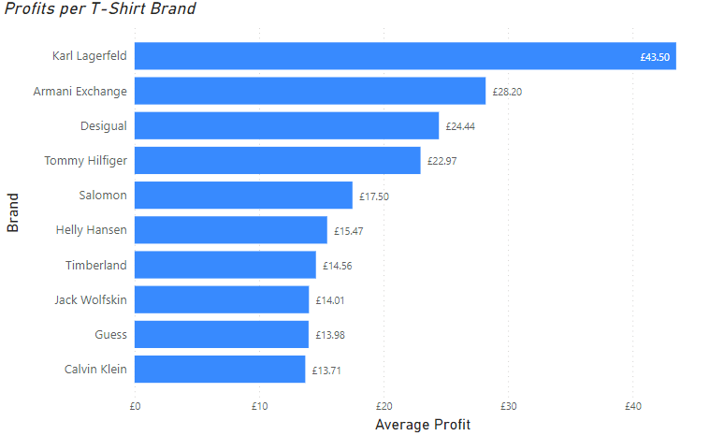
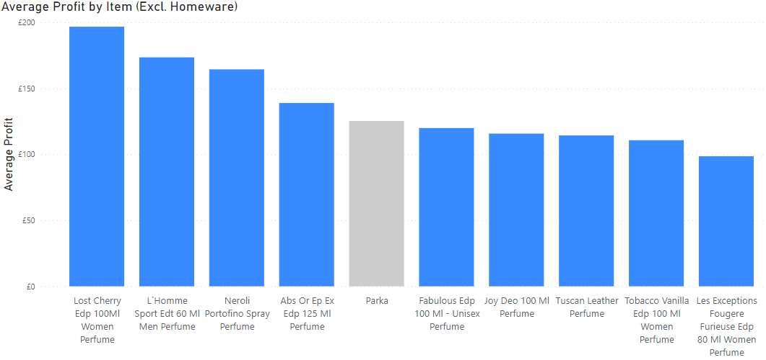
Potential for upselling
In our most popular clothing category, T-Shirts, great potential for upselling highly profitable alternatives.
Most common T-Shirt, Prism own brand, which makes up around 40% of T-Shirt sales, generates a profit of just £4.63 per unit.
Perfume makes up 9/10 of most profitable items, gives potential for add-ons and bundle deals.
Offer alternatives to popular items whilst viewing and at the basket - “Customers also liked…”.
Offer add-ons like a tailored perfume to pair up with their items (with free shipping).
If we can get 5% of T-shirt buyers to upgrade, there would be a £33,250 increase in profit.
If 0.5% of buyers add on a perfume to their order, on average, we would see a £72,136 increase in profit.

Slide 8
Conclusion
Optimise traffic to bring high intention customers based on source preferences.
Offer basket pair bundles and complimentary seasonal recommendations.
Upsell more profitable items as upgrades or add-ons.

Slide 9
Any Questions?
Thank you for listening!

